Slide 1
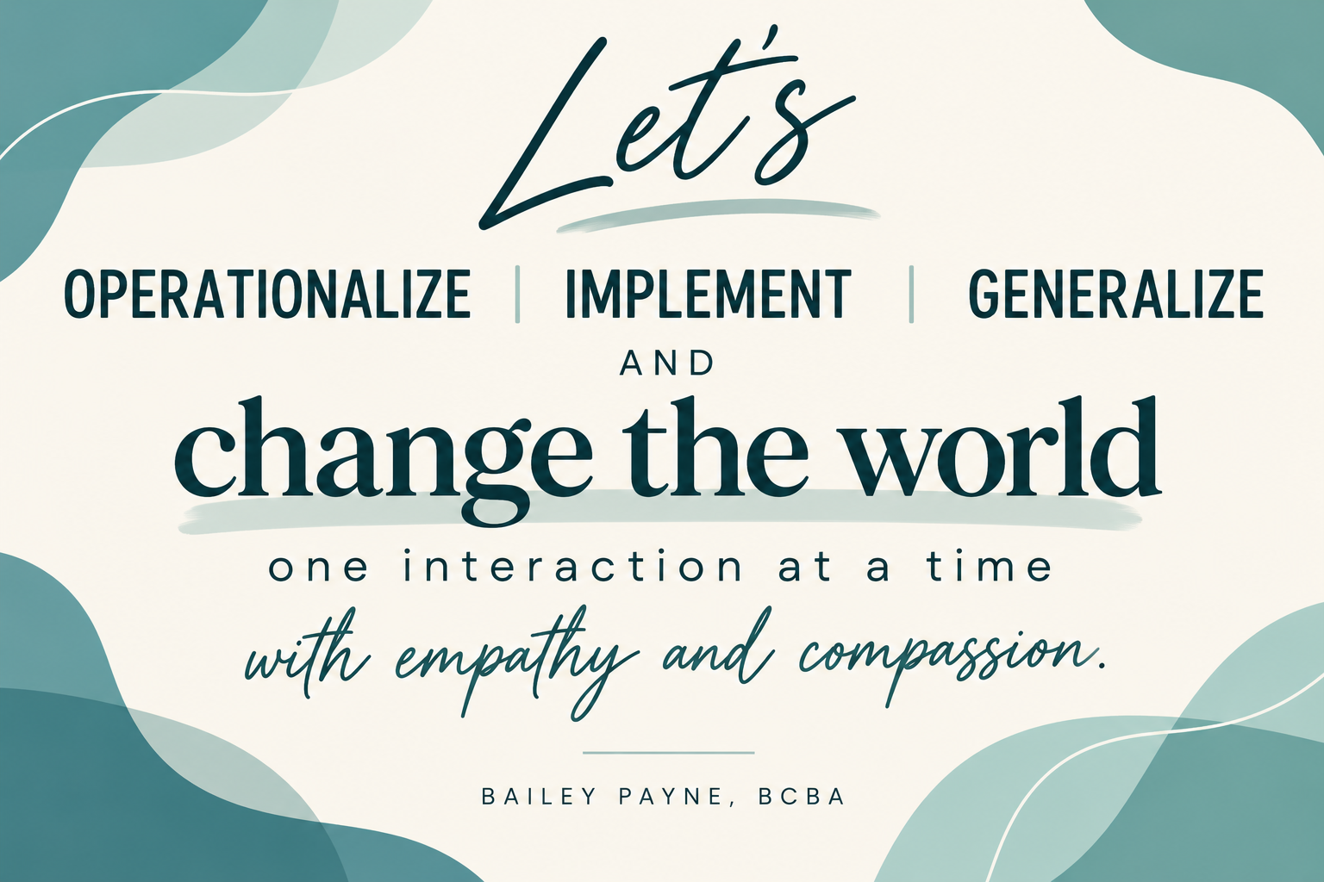

Empathy in Supervision
Compassion is not the absence of standards. It is the way we help people learn to meet them.

Slide 2
Why This Training Matters
Technical competence alone is not the full supervisory repertoire.
Most surveyed behavior analysts reported little or no formal graduate training in compassion, empathy, and relationship-building.
Supervisors often become responsible for shaping these repertoires in future BCBAs.
Perceived supervisor support mediated the relationship between supervisor compassion and staff burnout.
LeBlanc et al. (2020); Austin & Fiske (2023).

Slide 3
A Note of Caution
This is my interpretation, my approach, and my perspective on behavior change and compassion.
It has been shaped by my professional training and education, but it has also been shaped by my values, lived experiences, relationships, mistakes, successes, and learning history.
And that distinction matters.
Compassion is not a perfectly objective set of procedures. The way we understand compassion, demonstrate it, and recognize it in others is influenced by our own learning histories.
So, I am not presenting this perspective as the definition of compassionate behavior analysis. I am offering it as a perspective and inviting you to examine it alongside your own.
Because after all, our learning histories shape how we see behavior, and they also shape how we define compassion.
LeBlanc et al. (2020); Austin & Fiske (2023).

Slide 4
Learning Objectives
Identify at least three observable supervisor behaviors that operationalize empathy and compassion.
2. Distinguish a skill deficit, performance barrier, and competing contingency before responding to supervisee performance.
3. Apply the 12 Behavior Breakthrough skills to supervision while maintaining competency expectations.
Construct feedback that combines clarity, collaboration, reinforcement, and a teachable next step.

Slide 5
The Central Question
We routinely ask clients: What variables are influencing this behavior?
Do we ask the same question before labeling a supervisee?
Do we view adult behavior through a behavior analytic lens or do we let our own perspectives, perceptions, and learning histories guide who we label others?
We know better than this.

Slide 6
Empathy Through a Behavior-Analytic Lens
Empathy: perspective taking—attempting to understand another person's experience. Recognizing barriers that we truly have never been someone else and can’t begin to understand their experience because it’s not ours.
Compassion: moves beyond understanding toward action intended to alleviate difficulty or support effective responding. It’s about taking action of the perspective that we can’t begin to understand.
The useful supervisory question is not whether we feel empathic or even if we ARE empathetic.
It is: What does the supervisor do?
Observable examples: listening, asking questions, acknowledging concerns, minimizing jargon, explaining rationale, and collaborating.
Rohrer et al. (2021).

Slide 7
“I cannot fully understand someone else’s experience because I have not lived it,”
What Compassion Can Look Like Behaviorally
Ask instead of assume. “What would be helpful right now?”
Believe someone when they describe their experience.
Listen without immediately offering a solution.
Validate without claiming you understand.
Avoid “I know exactly how you feel.”
Ask permission before helping.
Accept a person's report even when their reaction is different from yours.
Change the environment when someone communicates a need. Compassion isn't only acknowledging discomfort. It can mean doing something differently because of what you learned.
Offer choices instead of deciding what someone needs.
Respect “no” without requiring justification.
Allow someone to change their mind.
Respond to distress before demanding explanation. A person shouldn't always have to articulate why they're struggling before receiving support.
Apologize when your behavior causes harm, even when harm wasn't your intention.
Ask for feedback about your own behavior.
“Was the way I responded helpful?”
Change your behavior based on feedback.
Tolerate not knowing. Compassion doesn't require having an explanation for another person's behavior.
Stay curious longer than you stay certain.

Slide 8
Empathy Is Not...
Empathy changes HOW we support performance, not WHETHER performance matters.
-Lowering competency standards.
-Avoiding corrective feedback.
-Ignoring ethical or performance concerns.
-Removing every difficult task.
-Agreeing with every supervisee interpretation.
-Taking responsibility for behavior the supervisee must learn.

Slide 9
The Empathy Shift
Instead of “They should know this.” → Was this skill explicitly taught, modeled, rehearsed, and reinforced?
Instead of “They don't take feedback.” → What about the feedback context may evoke avoidance or defensiveness?
Instead of “They aren't motivated.” → What consequences currently compete with the performance I want?
Instead of “I already told them.” → Can they perform it independently under the conditions that matter?

Slide 10
What the Research Tells Supervisors
LeBlanc et al. found limited formal training in compassion, empathy, and therapeutic relationship skills.
Relationship-building was often addressed through mentored practical experience—placing supervisors in a critical teaching role.
Supervisors need training so they can identify and shape compassionate and empathic repertoires in trainees.
For many future BCBAs, supervision may be where these behaviors are actually learned.
LeBlanc et al. (2020).

Slide 11
Compassion and Supervisor Support
Austin & Fiske surveyed 1,335 ABA providers.
Perceived supervisor support mediated the relationship between supervisor compassion and staff burnout.
Prior literature summarized in the article links supervisor support with lower burnout and higher job satisfaction.
Availability and praise may support supervisees; lack of availability, lack of praise, punishment, and insincere praise can be problematic.
Austin & Fiske (2023).

Slide 12
Soft Skills Are Behaviors
Compassionate interpersonal skills can be translated into observable behavior rather than treated as personality traits.
That means supervisors can model, prompt, rehearse, give feedback on, and reinforce them.
Future BCBAs should experience compassionate supervision AND learn how to deliver compassionate care themselves.
It’s more than operationally defining compassion. It’s more than providing a list of examples. It’s about modeling and BEING so our behavior becomes someone’s guide and inner voice of love.
Rohrer et al. (2021).

Slide 13
Knowledge Does Not Equal Capacity
Knowing what to do does not always mean someone can do it successfully under the current conditions.
Before responding to supervisee performance, get curious about what is getting in the way.
-SKILL DEFICIT
“I don’t know how yet.”
Supervisor response: Teach → Model → Practice → Feedback
-PERFORMANCE BARRIER
“I know how, but something is making it difficult right now.”
Supervisor response: Identify the barrier → Adjust support → Practice under realistic conditions
-COMPETING CONTINGENCY
“Another behavior is currently more valuable or efficient.”
Supervisor response: Examine the contingencies → Reduce response effort → Strengthen reinforcement for the desired behavior
Compassion Requires Us to Ask Before We Assume
“Is this person unwilling to do it, or have I not yet understood what is influencing their ability to do it?”
Don’t reteach a skill when the problem is the environment.
Don’t increase stress when the problem is capacity.
Assess before you respond.
Rohrer et al. (2021).

Slide 14

A Practical Framework: 12 Skills
Behavior-change strategies can also improve how we supervise behavior-change agents.
1. Descriptive Praise
2. Stating Things Positively
3. Intentional Delivery of Preferred Outcomes
4. First/Then
5. Directed Choices
6. Addressing Denials
7. Antecedent Expectations
8. Behavioral Function
9. Reinforcement
10. Visuals
11. Timers / Time Boundaries
12. Reinforcement vs. Bribery

Slide 15
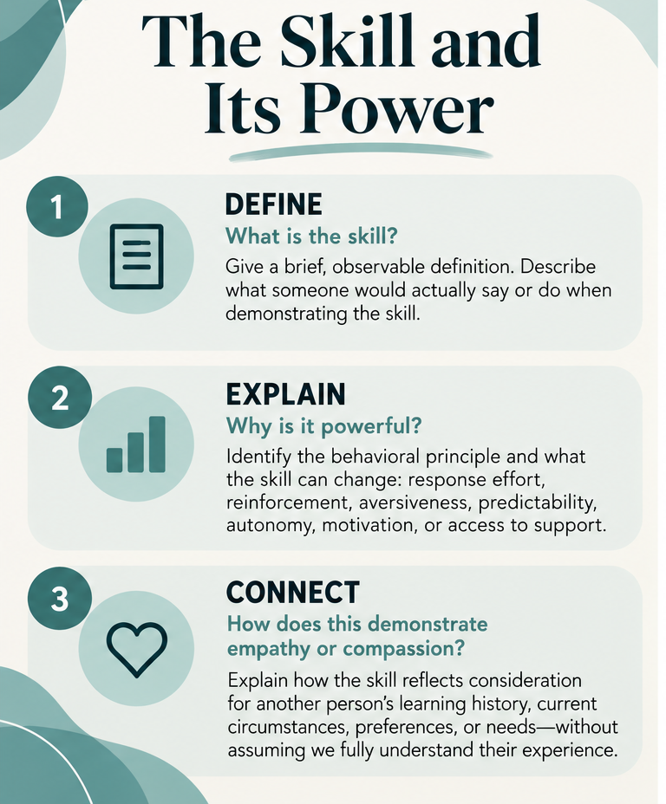
1. Descriptive Praise

Slide 16
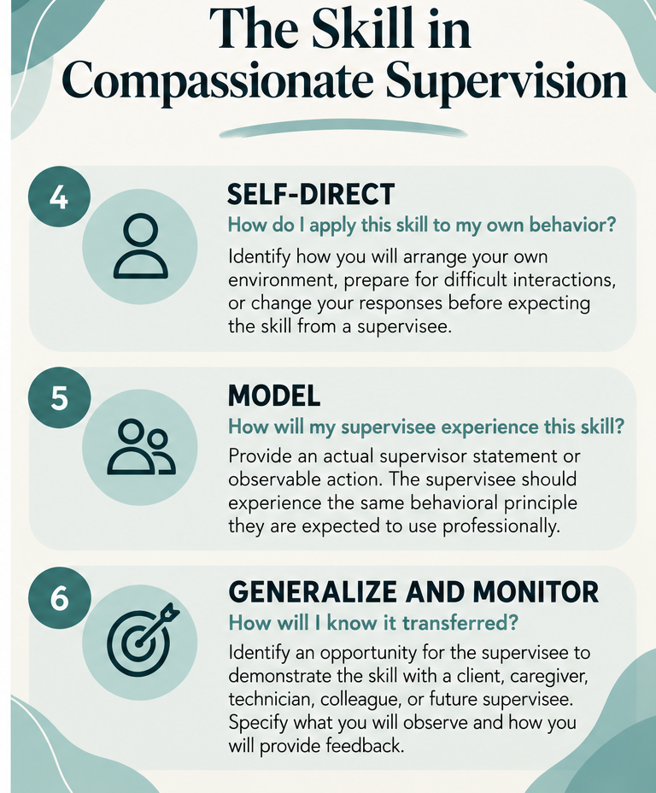
1. Descriptive Praise

Slide 17
2. Stating Things
Positively

Slide 18
2. Stating Things
Positively

Slide 19
3. Delivery of Preferred
Outcomes

Slide 20
3. Delivery of Preferred
Outcomes

Slide 21
4. First/Then
Contingencies

Slide 22
4. First/Then
Contingencies

Slide 23
5. Directed Choices

Slide 24
5. Directed Choices

Slide 25
6. Addressing Denials

Slide 26
6. Addressing Denials

Slide 27
7. Antecedent
Expectations

Slide 28
7. Antecedent
Expectations

Slide 29
Let’s Generalize…
Self-Direct, Model, Generalize
8. Behavioral Function
9. Reinforcement
10. Visuals
11. Timers
Discriminating bribes from reinforcement

Slide 30
Let’s Get Vulnerable and Be Real…
Power affects what we get to observe.
A Supervisee’s agreement does not necessarily mean understanding or confidence. What have we taught them happens when we disagree, admit uncertainty, or report a mistake.

Slide 31
Let’s Get Vulnerable and Be Real…
Our own behavior has a function
Correcting quickly, taking over, or increasing demands may relieve the supervisor’s discomfort without developing the supervisee’s competence (and the relationship surrounding building it).

Slide 32
Let’s Get Vulnerable and Be Real…
Accountability includes the conditions for success
We can maintain a performance standard while examining whether instruction, practice, resources, and feedback adequately support it.

Slide 33
Compassionate Feedback: A 4-Step Sequence
Feedback can be both corrective and compassionate.
It’s a two-part process- What does the supervisee need to learn and what does the supervisor need to be aware of regarding their own behavior?
1. Observe: Describe what happened without labels or inferred intent.
2. Understand: Ask what variables, barriers, or uncertainty affected performance.
3. Teach: State the expected behavior; model or rehearse when needed.
4. Reinforce + follow up: Notice improvement and verify independent performance later.
5. Interweave the behavioral skills training (Behavior Breakthrough Skills) by self-directing, modeling, and generalizing.
Rohrer et al. (2021); LeBlanc et al. (2020).

Slide 34
Case Practice: “They Don't Take Feedback”
A trainee becomes quiet, gives short answers, and avoids eye contact after you identify errors in a behavior plan. At the next supervision meeting, the revisions are incomplete.
What does the supervisee need to learn and what does the supervisor need to be aware of regarding their own behavior?
1. Observe: Describe what happened without labels or inferred intent.
2. Understand: Ask what variables, barriers, or uncertainty affected performance.
3. Teach: State the expected behavior; model or rehearse when needed.
4. Reinforce + follow up: Notice improvement and verify independent performance later.
5. Interweave the behavioral skills training (Behavior Breakthrough Skills) by self-directing, modeling, and generalizing.

Slide 35
Case Practice: Compassion + Accountability
1. OBSERVE
What happened?
Supervisor self-direction: “I need to focus on observable behavior, not assume the supervisee is upset, disengaged, or unwilling.”
2. UNDERSTAND
Identify the barrier before responding.
Supervisor self-direction: “Was my feedback clear and actionable? Did I provide enough instruction, or did I only identify errors?”
3. TEACH
Supervisor: “Let's revise the first section together. Then you'll practice the second while I provide feedback. We'll create a checklist for the remaining revisions.”
4. REINFORCE + FOLLOW UP
5. INTERWEAVE BEHAVIOR BREAKTHROUGH SKILLS
Key Takeaway
Compassion isn't removing corrective feedback. It's making feedback clear, teachable, and supportive of meaningful change.

Slide 36
Self-Check for the BCBA Supervisor
Do I ask questions before making assumptions?
Can my supervisee describe exactly what successful performance looks like?
Do I provide specific reinforcement as often as I provide correction?
Does my feedback teach a replacement behavior?
Do I acknowledge my own behavior and perspectives first?
Am I shaping independence or creating dependence on my prompts?
Would I want my supervisee to use my interaction style with a caregiver or staff member? (Behavior Breakthrough Skills)
Conceptually aligned with Rohrer et al. (2021).

Slide 37
What We Want Future BCBAs to Learn
Technical accuracy AND humane implementation.
Functional analysis of behavior AND curiosity about context.
Clear standards AND collaborative communication.
Corrective feedback AND celebrations of “being enough” as a human.
Professional boundaries AND compassion.
Independence that was systematically taught, practiced, and shaped.

Slide 38
Let’s Generalize…
“Families have reported that treatment plans have been too prescriptive in nature, leading these families not even to attempt to build a relationship with the behavior analyst and move away from receive ABA Services” (Horbanczuk, Fettig &Luna, 2024)

Slide 39
Comprehension Check
1. Which response best demonstrates empathy while maintaining accountability?
2. Name two variables a supervisor should assess before labeling a trainee as “unmotivated.”
3. Select one Behavior Breakthrough skill and describe how it could be used to shape future BCBA performance.

Slide 40
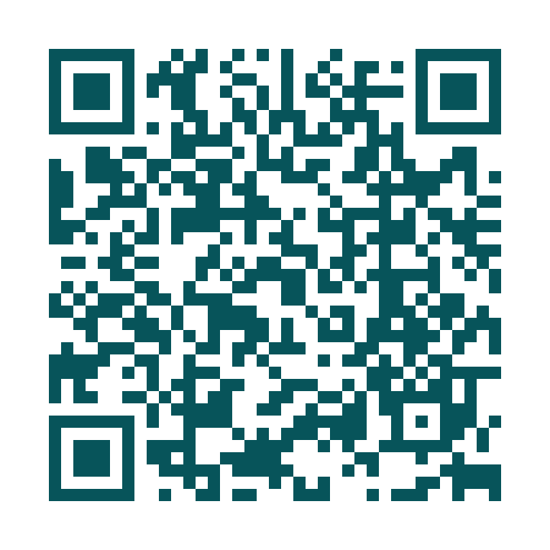
Complimentary Download
Compassionate Supervision Checklist

Slide 41
References
Austin, A., & Fiske, K. (2023). Evaluating the relationship between compassion, perceived supervisor support, and burnout among ABA staff. Behavior Analysis in Practice.
LeBlanc, L. A., Taylor, B. A., & Marchese, N. V. (2020). The training experiences of behavior analysts: Compassionate care and therapeutic relationships with caregivers. Behavior Analysis in Practice, 13, 387–393.
Rohrer, J. L., Marshall, K. B., Suzio, C., & Weiss, M. J. (2021). Soft skills: The case for compassionate approaches or how behavior analysis keeps finding its heart. Behavior Analysis in Practice.
Behavior Breakthrough framework: 12 practical behavior-change skills adapted here for supervision of future BCBAs.

Slide 42
Reach Out!
Bailey Payne
info@baileypayne.com
www.baileypayne.com

